Slide 1
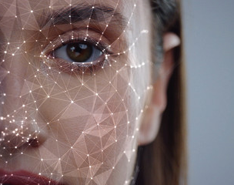
Image Recognition
Pooja Bera
Prajakta Digambar Sirame
Nataly Martinez Romero
Carolina Velasquez Velasquez

Slide 2
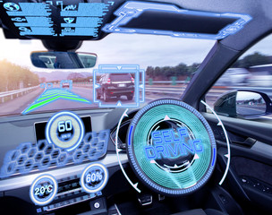
Definition (Nata)
image regnition

Slide 3
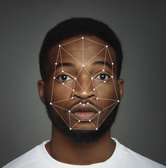
Definition (Pojja)
Face recognition

Slide 4
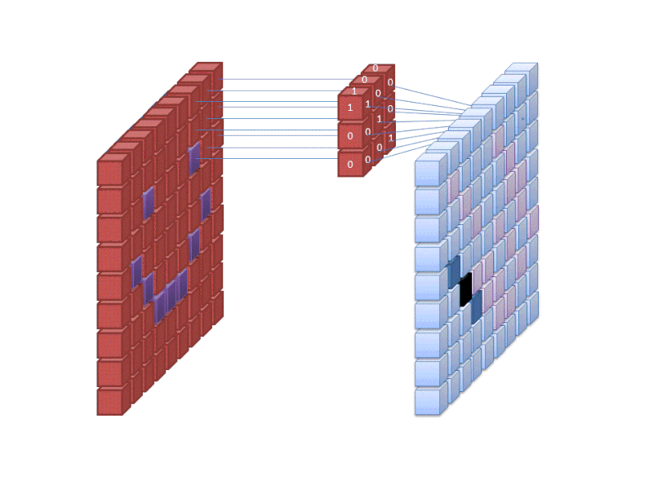
Feature Extraction (Caro)

Slide 5
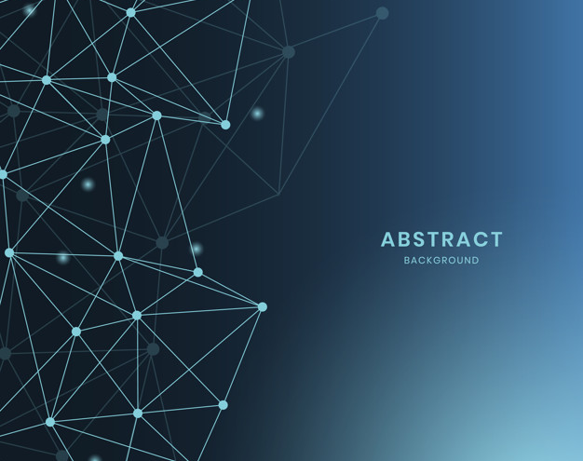
Convolutional network (Nata)

Slide 6
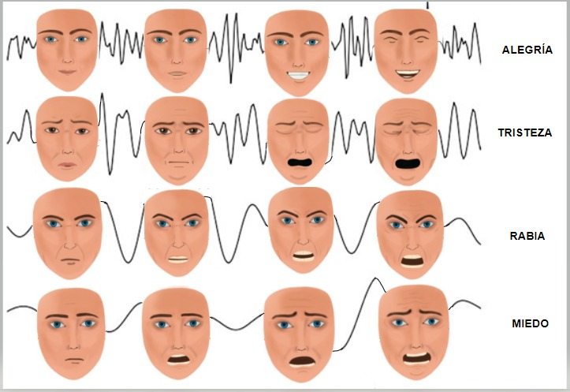
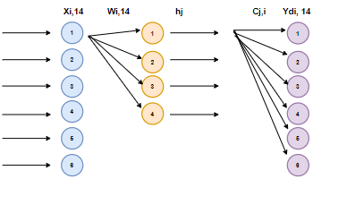
Neuronal Aplication (Nata)

Slide 7
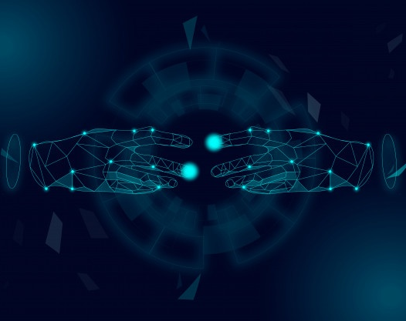
Machine learning (Caro)

Slide 8
Example (Prajakta)

